Slide 1
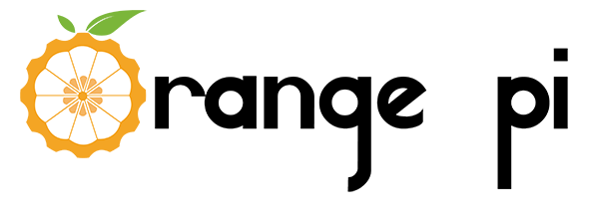
AI Stick
Easy to learn and use, accelerate the industrialization of artificial intelligence, and let the public become an expert in AI

Slide 2
AI Chip SPR2801S Introduction
01
Orange Pi AI Stick Introduction
02
CONTENT
Orange Pi AI Application
03
Physical Photo
04

Slide 3
SPR2801S Introduction
01

Slide 4
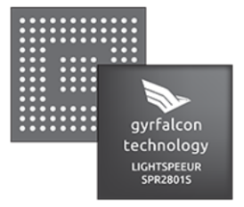
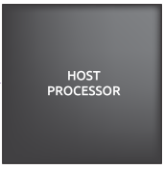
AI Chip SPR2801S Introduction
Low Cost
As a coprocessor,SPR2801S constitutes a heterogeneous computing system with CPU, no additional memory required, efficient and reasonable；
Low Power Consumption
The typical power consumption of SPR2801S is 0.3W, energy efficiency reaches 9.3TOPs/W
The SPR2801S is a deep learning neural network accelerator chip that is developed by Gyrfalcon Technology Inc. It provides superior computing power and experience for terminal and cloud AI products and systems, significantly speeding up the deployment of popular applications in the field of AI
High Performance
SPR2801S integrates up to 28,000 computing units, providing 2.8 trillion calculations per second

Slide 5
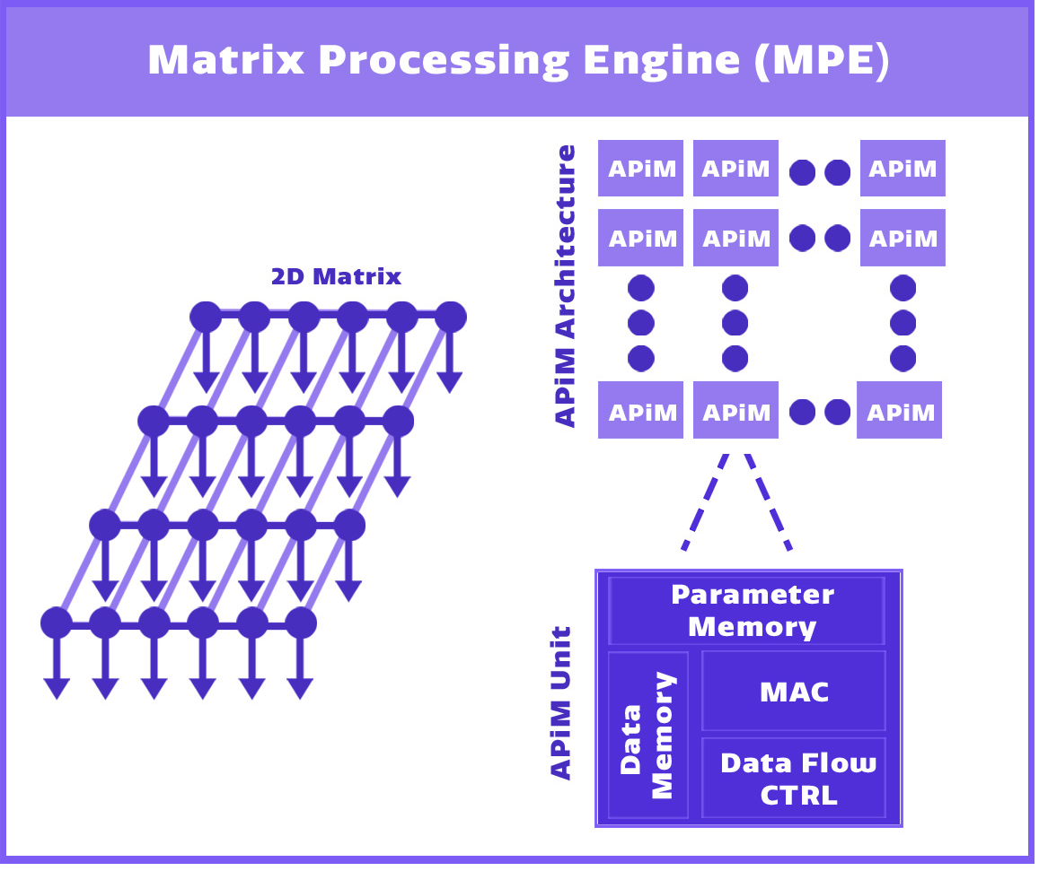
AI Chip SPR2801S Introduction
Energy efficiency | 9.3 TOPs/Watt
low power consumption | 2.8 TOPs @300mW
Peak performance | 5.6 TOPs @100MHz
Chip package | BGA(7mm*7mm)
Open source framework | Caffe，PyTorch，(TensorFlow will be supported soon)

Slide 6
Orange Pi AI Stick Introduction
02

Slide 7
Orange Pi AI Stick Introduction
Orange Pi AI Stick
Built-in Lightspeeur® optical spear SPR2801AI chip. The flexible and fast way of the USB interface enables mobile phones, personal computers and other devices to directly run real-time deep learning and realize the ability of picture, video, voice and natural language recognition.
Low threshold
Easy to use
Easy to develop

Slide 8
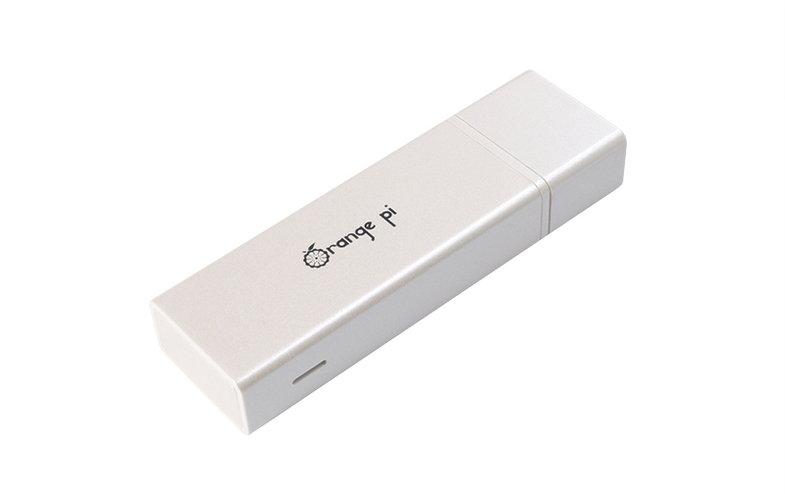
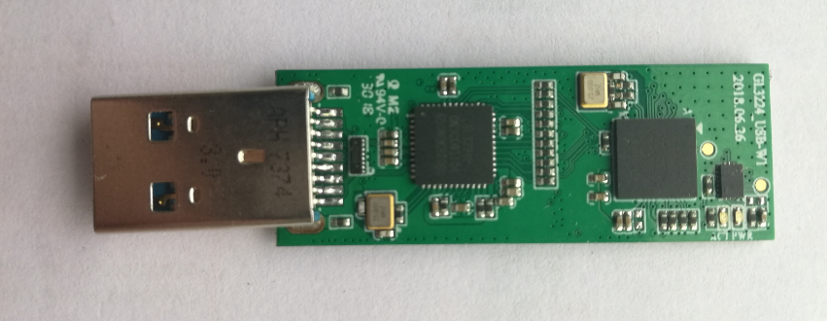
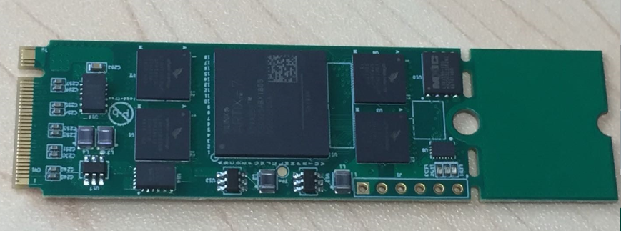
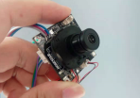
Orange Pi AI Stick Introduction
Characteristics
Support USB2.0 and 3.0 standard interface communication
No programming, no language barriers
Open SDK, can be applied to platforms such as X86, ARM,etc.
Support Android, Linux and other operating systems
Support VGG, SSD and other neural network models

Slide 9
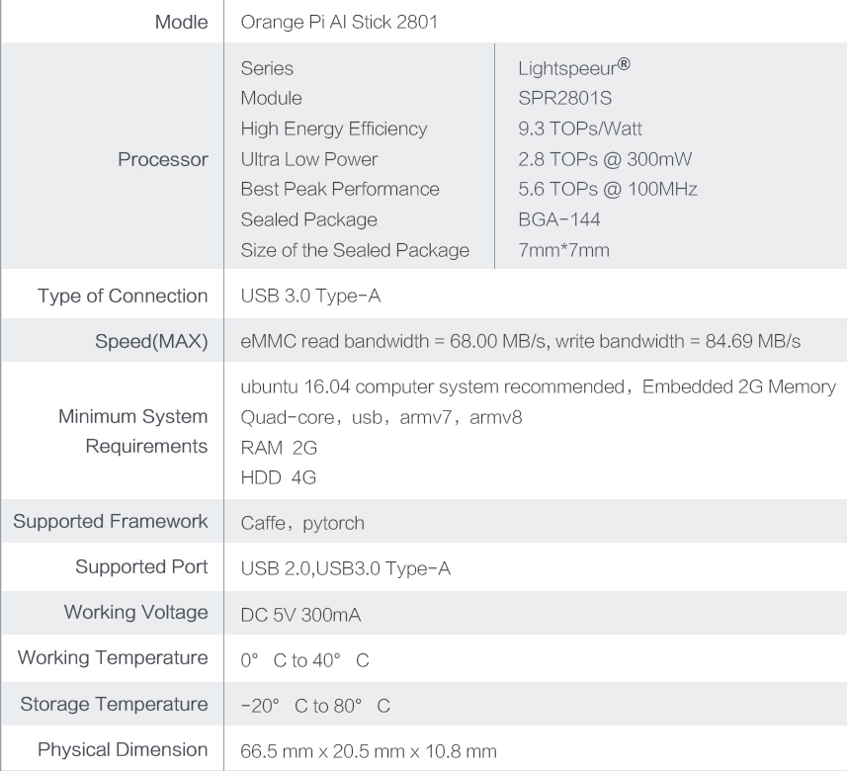
Specification sheet

Slide 10
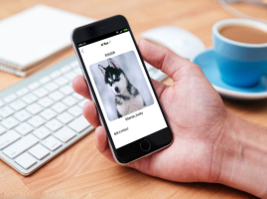
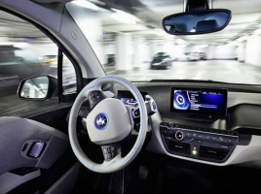
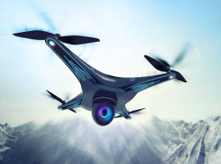
Application direction
Moving edge calculation
Intelligent monitoring
Smart toys and robots
Smart home
Virtual reality and augmented reality
Face detection and recognition
Speech Recognition
Natural language processing
Embedded deep learning device
Cloud Machine Learning and Deep Learning System
Artificial intelligence data center server
Advanced assisted driving and autonomous driving

Slide 11
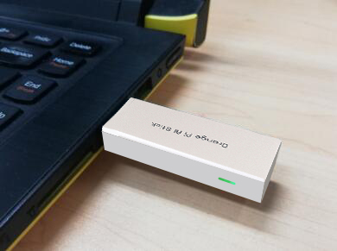
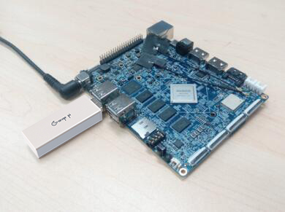
Application direction
Development model
/
AI Stick+PC
AI Stick+ARM Development board

Slide 12
Orange Pi AI Application
03

Slide 13
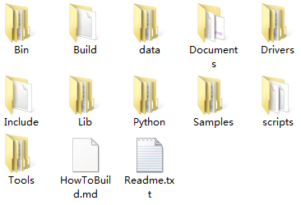
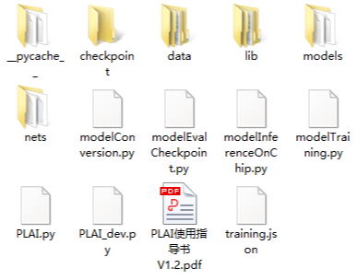
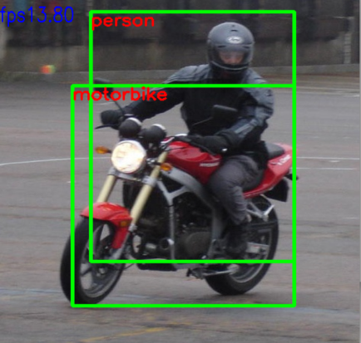
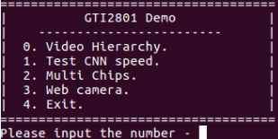
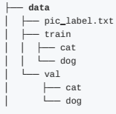
Development and use of three steps
1
2
3
DEMO
Model training and conversion
system integration
AI Stick+X86/ARM
a.Prepare the marked material or existing pre-trained model
a.Reference SDK integration model
a.Download SDK
b.Use the PLAI tool
b.Reference SDK customization program
b.Build a GTISDK demo environment
c.Run the run-cnn.sh script
c.execution python PLAI.py
d. .dat or .bin

Slide 14
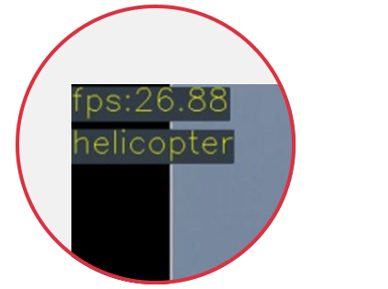
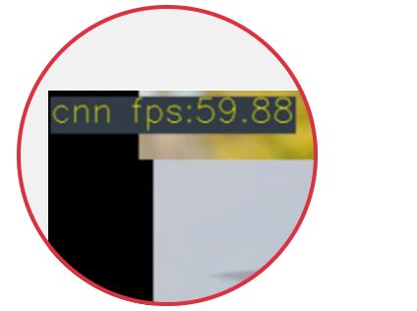
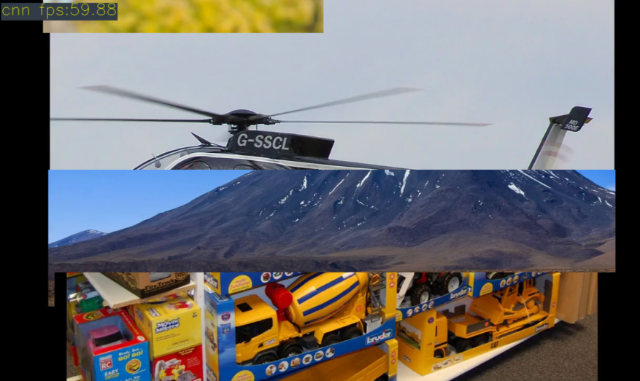
Product demonstration effect
Image detection demo
Chip convolution speed demonstration

Slide 15
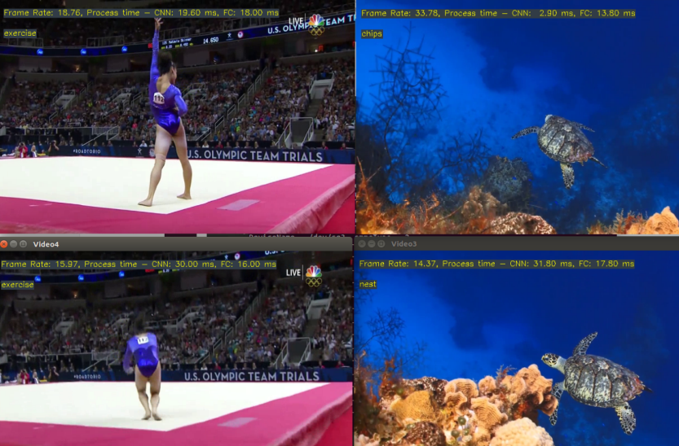
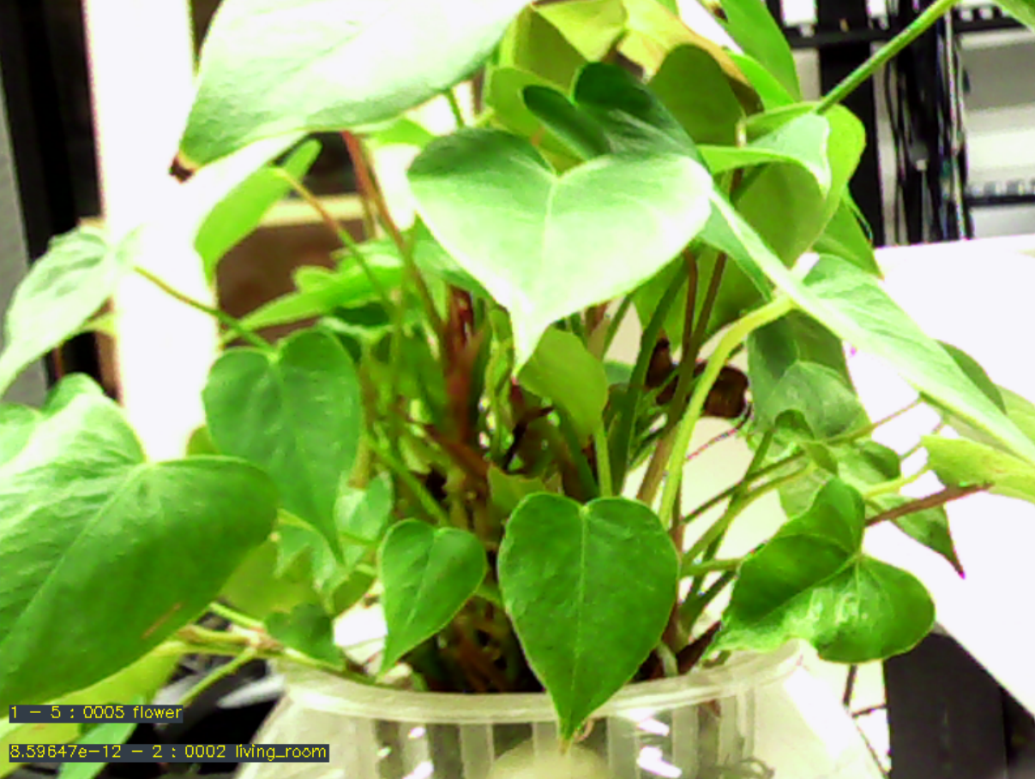
Product demonstration effect
Multiple neuron calculations
Camera screen capture

Slide 16
FAQ
1.Where could I buy the Orange Pi AI Stick 2801?
A:We have Taobao and Aliexpress Store, you could enter the store from our official website by clicking ‘point me to buy the boards’ to order products.
2.Could I get the same support for the Orange Pi AI Stick 2801 if i order it from different stores?
A: You could get the same support if you make an order from our store and our partners’ store. We adopt the policy of ‘Registration First,Service Next’,which means we provide product and technical support according to the order records.
3.What kind of neural network model and model size are supported by SPR2801AI chip, and what are the requirements and resource constraints for input data?
A:Currently SPR2801 supports image classification model VGG and target detection model SSD, etc., input data of 224*224*3 pictures
4.Which OP are specifically supported by SPR2801AI chips?
A:This hip architecture is different from the‘Von Neumann’ general processor, no instruction set, no tool chain (compiler, etc.) and without programmability. The API currently provided does not include any independent operations (such as conv, relu, pooling, etc.). In other words, developers can not directly access the chip's computing units, which is different from general APIs that call the chip's internal computing units or modules through APIs or instructions.

Slide 17
FAQ
5.The SPR2801AI chip connect to the host via the USB neural network stick, how does the chip and the host divide the work? What are resource requirements of software and hardware for host?
A: The SPR2801 chip processes the CNN convolution calculation of the backbone network, and the host processes non-CNN calculation. The neural network computing stick can be applied to Linux (x86, arm) and Android (ARM) platforms. It is recommended to be carried out on the X86 LINUX platform. In practical applications, CPU selection is related to system configuration and application.
6.How to use the SDK of the neural Orange Pi network computing stick?
A: We have provided SDK and detailed instructions. Please download SDK development kit through the link and read the instructions document in detail.

Slide 18
Physical Photo
04

Slide 19
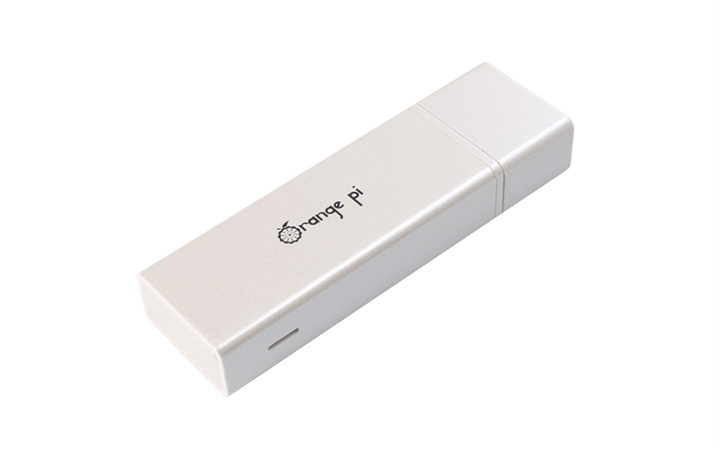
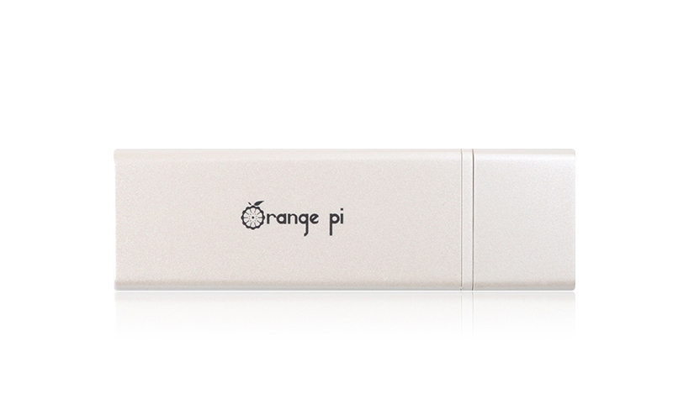
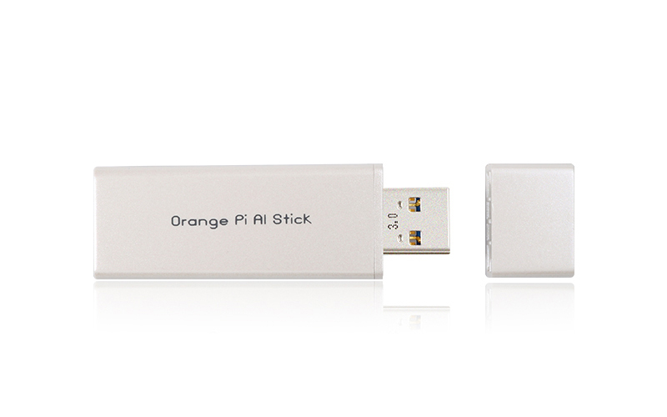
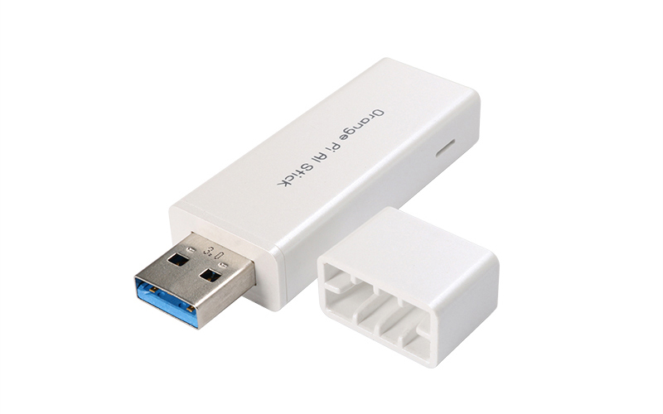
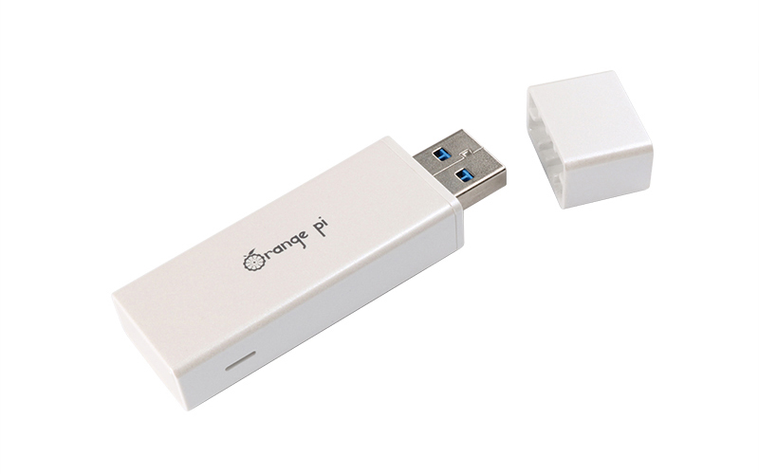
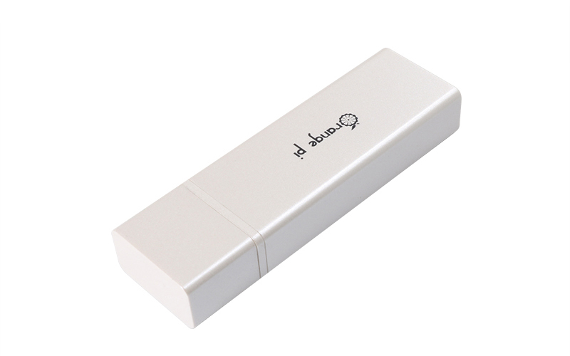
Physical Photo

Slide 20
Thanks
https://www.orangepi.cn/

